Slide 1

7th Grade Math
Unit 5, Lesson 9 Solving Problems Involving Dimensions and Areas of Geometric Figures Volume 1, pg. 223

Slide 2


Benchmark
MA.7.GR.1.5
Solve mathematical and real-world problems involving dimensions and areas of geometric figures, including scale drawings and scale factors.
volume 1, pg. 223

Slide 3
Integrated Mathematical Thinking and Reasoning Standards
MA.K12.MTR.5.1 Use patterns and structure to help understand and connect mathematical concepts.
MA.K12.MTR.6.1 Assess the reasonableness of solutions.
MA.K12.MTR.7.1 Apply mathematics to real-world contexts.
volume 1, pg. 223

Slide 4

Learning Target
I can solve mathematical and real-world problems involving dimensions and perimeters of geometric figures.
volume 1, pg. 223

Slide 5

Warm-Up
volume 1, pg. 224

Slide 6
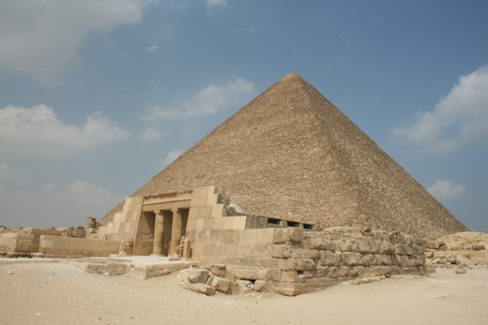
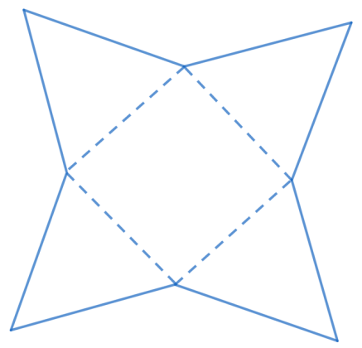
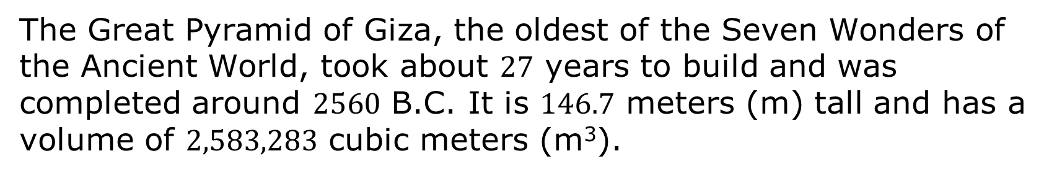
5.9.1 Warm-Up: Between Two Numbers
The Great Pyramid of Giza, the oldest of the Seven Wonders of the Ancient World, took about $27$ years to build and was completed around $2560$ B.C. It is $146.7$ meters (m) tall and has a volume of $2,583,283$ cubic meters (m³).
volume 1, pg. 224
Notes:
Video Link: https://algebranation.wistia.com/medias/fi4fidi5y8

Slide 7

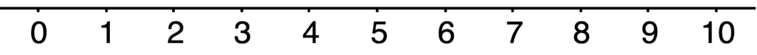
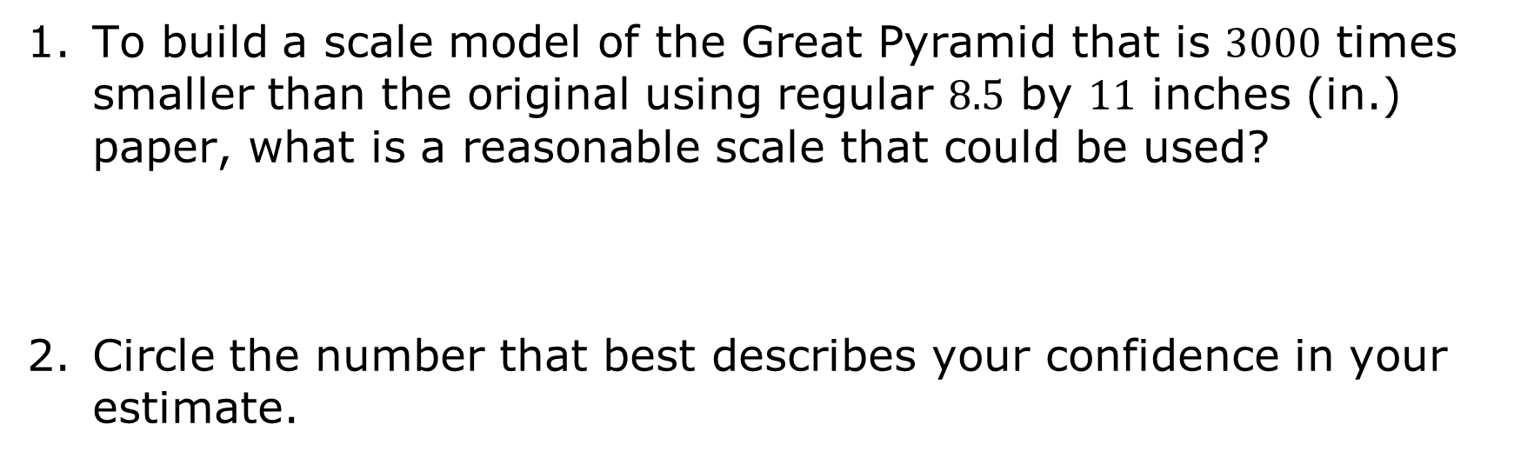
To build a scale model of the Great Pyramid that is $3000$ times smaller than the original using regular $8.5$ by $11$ inches (in.) paper, what is a reasonable scale that could be used?
Circle the number that best describes your confidence in your estimate.
volume 1, pg. 224
Notes:
Video Link: https://algebranation.wistia.com/medias/fi4fidi5y8

Slide 8

Guided Practice
volume 1, pg. 224

Slide 9

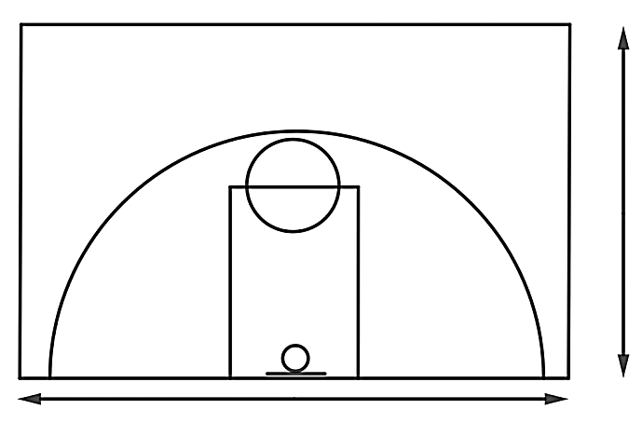
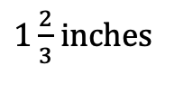
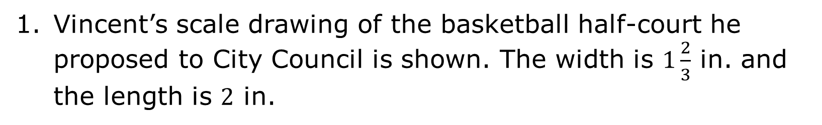
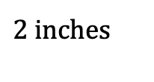
5.9.2 Guided Practice: Scales and Area
Vincent’s scale drawing of the basketball half-court he proposed to City Council is shown. The width is $1\frac{2}{3}$ in. and the length is $2$ in.
$1\frac{2}{3}$ inches
$2$ inches
volume 1, pg. 224

Slide 10
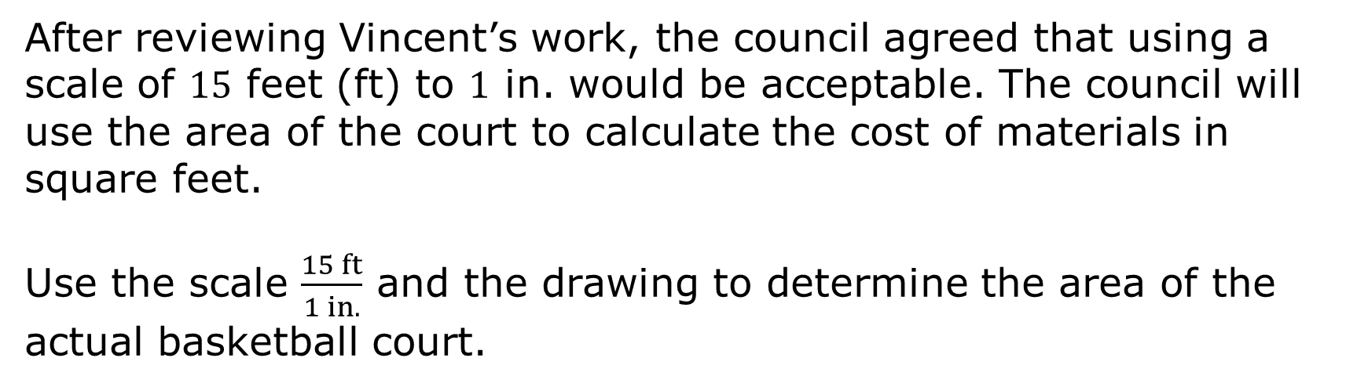
After reviewing Vincent’s work, the council agreed that using a scale of $15$ feet (ft) to $1$ in. would be acceptable. The council will use the area of the court to calculate the cost of materials in square feet.
Use the scale $\frac{15 ft}{1 in.}$ and the drawing to determine the area of the actual basketball court.
volume 1, pg. 224

Slide 11
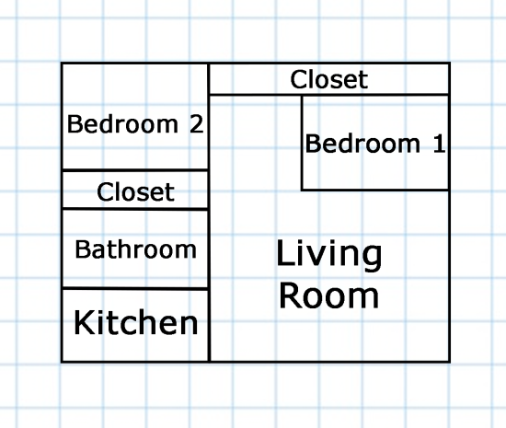
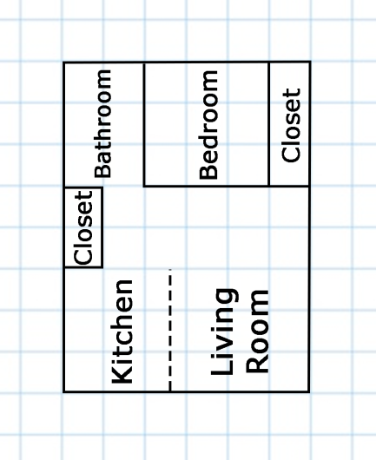
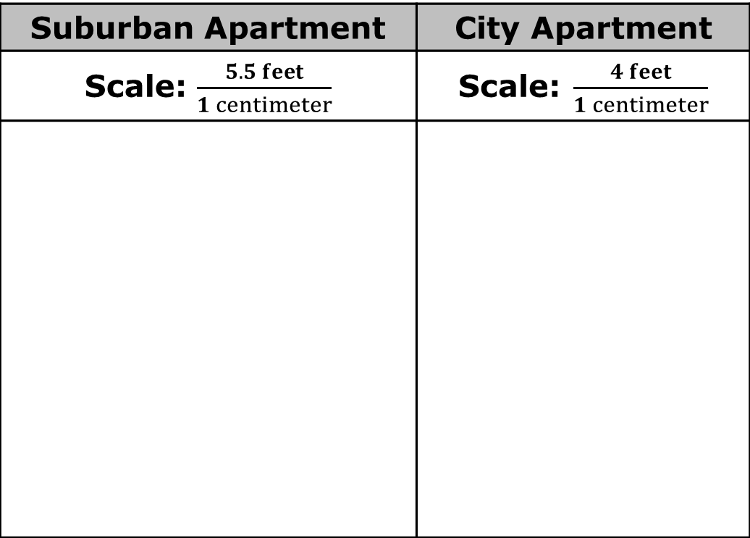
The models of two apartments are shown with the scales used to create them. Each gridline represents $1$ centimeter (cm).
Suburban Apartment | City Apartment
Scale: $\frac{5.5 feet}{1 centimeter}$ | Scale: $\frac{4 feet}{1 centimeter}$
volume 1, pg. 225

Slide 12
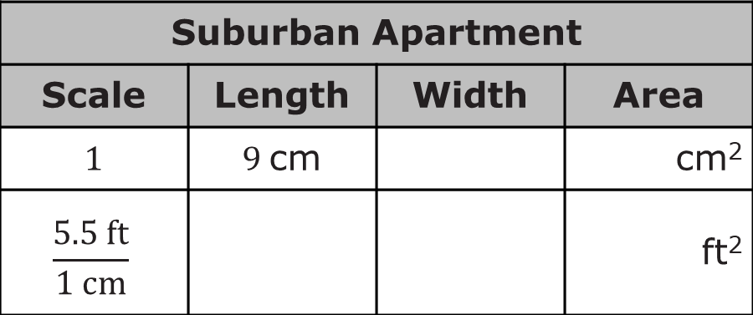
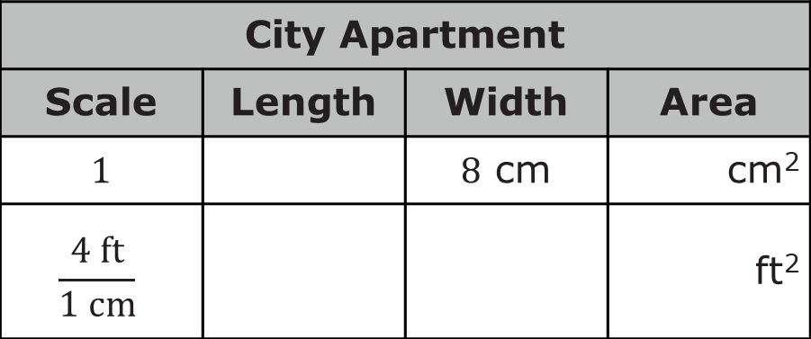
Complete the tables to find the dimensions and areas of both apartments.
Suburban Apartment
Scale | Length | Width | Area
1 | 9 cm |  | cm²
$$\frac{5.5 ft}{1 cm}$$ |  |  | ft²
City Apartment
Scale | Length | Width | Area
1 |  | 8 cm | cm²
$$\frac{4 ft}{1 cm}$$ |  |  | ft²
volume 1, pg. 225

Slide 13
Which apartment is larger?
Immanuel is looking for an apartment with as much closet space as possible. Explain which apartment you would recommend for him.
volume 1, pg. 225

Slide 14

Your Turn
volume 1, pg. 226

Slide 15
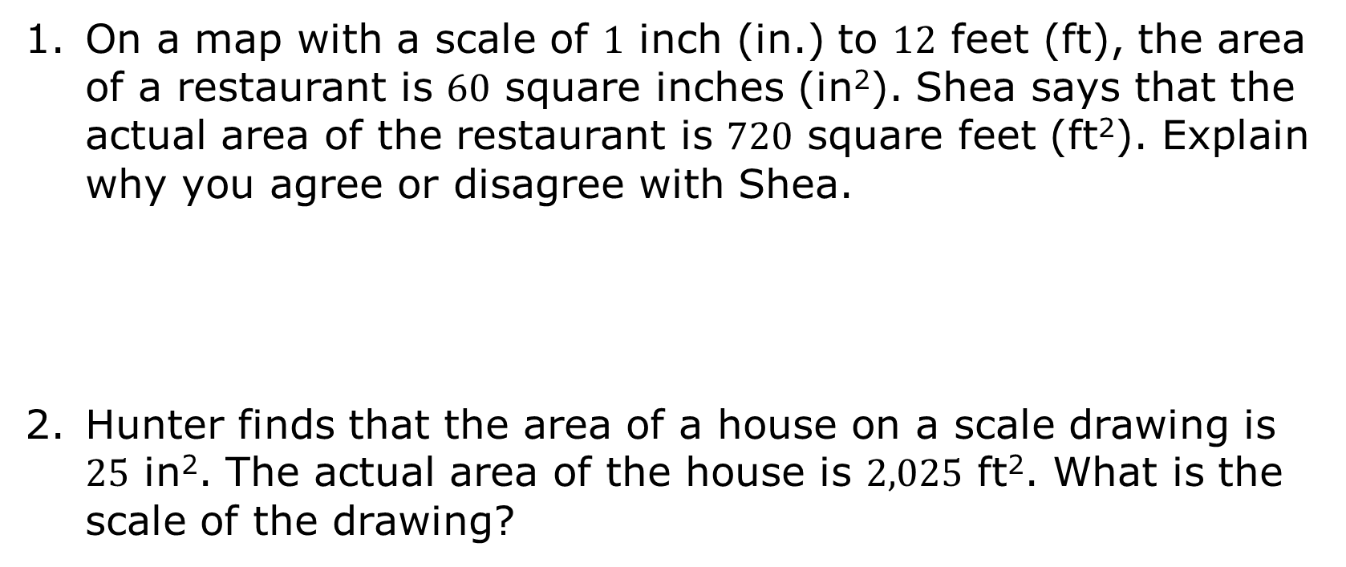
5.9.3 Your Turn!
On a map with a scale of $1$ inch (in.) to $12$ feet (ft), the area of a restaurant is $60$ square inches (in²). Shea says that the actual area of the restaurant is $720$ square feet (ft²). Explain why you agree or disagree with Shea.
Hunter finds that the area of a house on a scale drawing is $25$ in². The actual area of the house is $2,025$ ft². What is the scale of the drawing?
volume 1, pg. 226

Slide 16
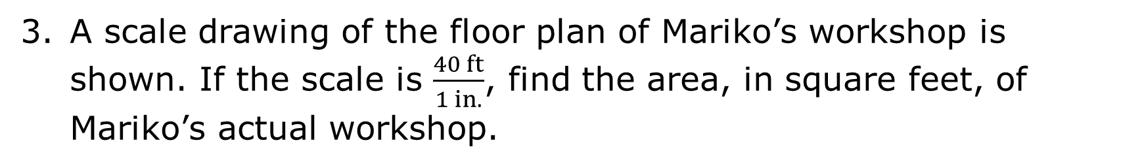


A scale drawing of the floor plan of Mariko’s workshop is shown. If the scale is $\frac{40 ft}{1 in.}$, find the area, in square feet, of Mariko’s actual workshop.
$1\frac{7}{8}$ in.
$2\frac{1}{2}$ in.
volume 1, pg. 226

Slide 17

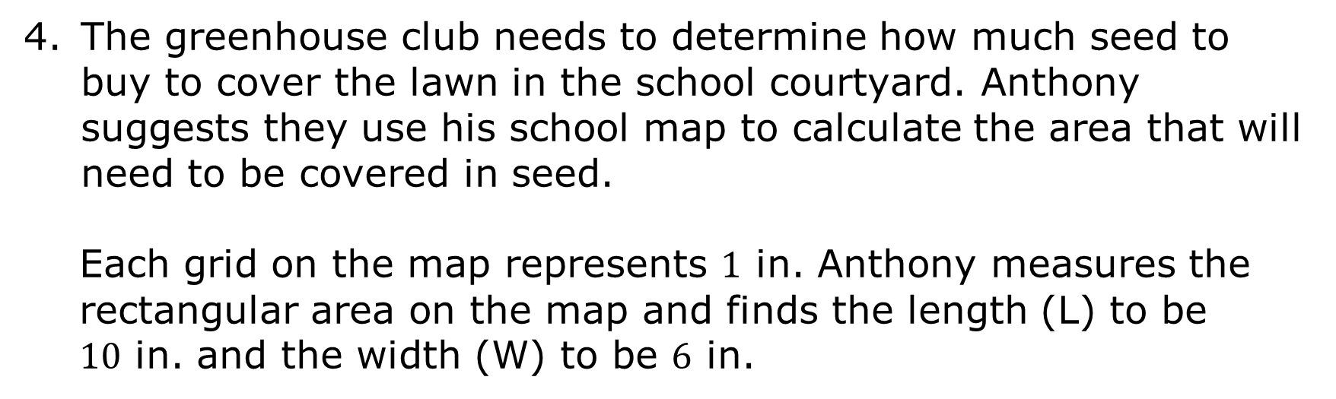


The greenhouse club needs to determine how much seed to buy to cover the lawn in the school courtyard. Anthony suggests they use his school map to calculate the area that will need to be covered in seed.
Each grid on the map represents $1$ in. Anthony measures the rectangular area on the map and finds the length (L) to be $10$ in. and the width (W) to be $6$ in.
School Lawn
W = $6$ in.
L = $10$ in.
volume 1, pg. 226

Slide 18
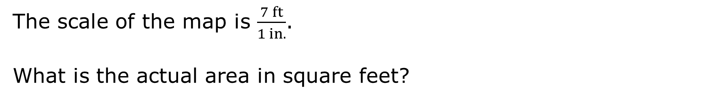
The scale of the map is $\frac{7 ft}{1 in.}$.
What is the actual area in square feet?
volume 1, pg. 226

Slide 19

Wrap-Up
volume 1, pg. 227

Slide 20
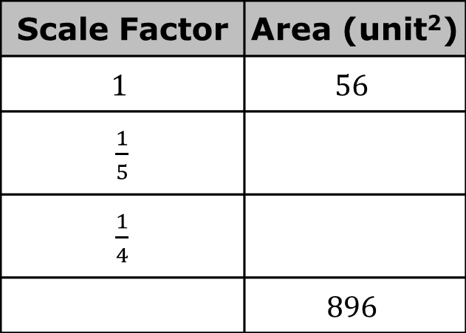
5.9.4 Wrap-Up: Cool Down
What is the relationship between a model’s scale factor and area?
Use that relationship to complete the following table.
Scale Factor | Area (unit²)
$$1$$ | $$56$$
$\frac{1}{5}$
$\frac{1}{4}$
 | $$896$$
volume 1, pg. 227

